Slide 1
Software Systems Design and Integration
Lecture 9, Part II
Java Server Faces Framework
© School of Computing (2012/2013)

Slide 2
Content
JSF as a presentation framework for Java EE
JSF Tags
Using Managed Beans in JSF facelets
  3.1 Configuring Managed Beans
  3.2 Referencing Beans in EL Expressions
  3.3 Populating Tables with Beans in facelets
JSF Forms
  4.1 JSF Tags for use with forms
  4.2 Managed Beans and Form Fields
  4.3 Page Navigation in JSF
  4.4 Data Processing in JSF
  4.5 Errors and Error Processing in JSF
5 JSP vs. JSF

Slide 3
1 JSF as a presentation framework for Java EE applications
Idea: Specifying the interface logically instead of designing it physically, as in JSP pages/servlets.
Facelets: XML files which contain the specification
  The facelets are written in View Description Language (VDL) and stored in .xhtml files on the server.
  The facelets refer to a library of UI components available to the application server, which uses them to generate the UI after the specification
  Unlike the standard XML, the facelets mix XML tags with EL expressions, like JSP. But unlike JSPs, the facelets are not pages but templates for pages

Slide 4
Facelets Interpretation
The XML facelets are accessed over HTTP like any other CGI compliant server-side component and the URLs are passed to the Web container for processing
The HTTP requests generated by the container are dispatched to the facelet servlet, which generates a temporary UI and populates it with the data from the HTTP request to form the actual request
The actual request is then processed by a Java class of the Web container and an HTTP response is generated by it by the facelet servlet
The HTTP response is then passed back to the server which generates the actual response

Slide 5
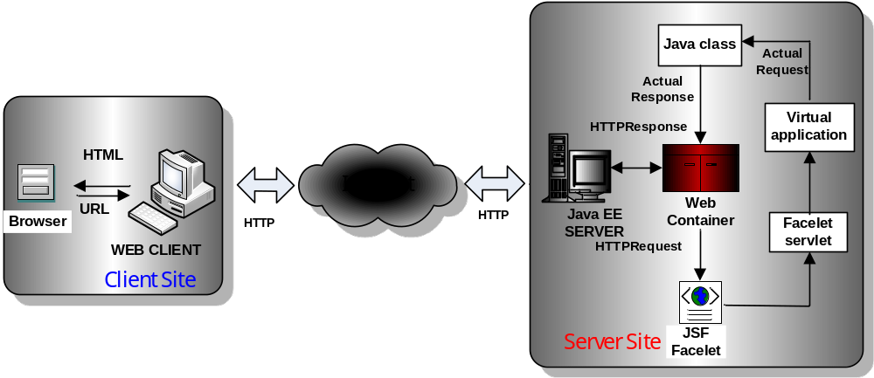
HTTP Request Processing in JSF

Slide 6
JSF Servlet
The servlet FacesServlet acts as generator
It needs to be configured in the web.xml file of the application
  <servlet>
  <servlet-name>FacesServlet</servlet-name>
  <servlet-class>javax.faces.webapp.FacesServlet </servlet-class>
  <load-on-startup>1</load-on-startup>
  </servlet>
  <sevlet-mapping>
  <sertvlet-name>FacesServlet</sertvlet-name>
  <url-pattern>*.xhtml</url-pattern>
  </sevlet-mapping>

Slide 7
Benefits
Removes the need to use physical components for building UI and reduces the browser specific knowledge
Some of the more difficult tasks in MVC developemet are fully automated (i.e., session control, navigation control, type conversion
Since the facelets are component-based, the interface development is object-oriented, similar to Swing
The facelets leverage the full power of JSP tags, incl. custom tags and EL expressions
Although there are other UI development frameworks (i.e., struts, Velocity, FreeMaker) JSF is standardized and supported by the Java EE-compliant servers

Slide 8
JSF Implementations
Two major releases of JSF - 1.2 (part of Java EE6) and 2.0 (part of Java EE7)
Some vendor specific implementations of the JSF specification
  Apache CoreJSF (JSF 1.2) and MyFaces (JSF 2.0)
  Jboss RichFaces (JSF 2.0)
  IceSoft IceFaces (JSF 2.0)

Slide 9
Example: Hello World Facelet
<?xhtml version=‘1.0’ encoding=‘UTF-8’ ?>
<!DOCTYPE html PUBLIC
“-//W3C//DTD XHTML 1.0 Transitional//EN”
“http://www.w3.org/TR/xhtml/DTD/xhtml1-
transitional.dtd”>
<html xmlns=http://www.w3.org/1999/xhtml
xmlns=http://java.sun.com/jsf/html”>
<h:head>
<title>Hello World</title>
</h:head>
<h:body>
<h:outputText value=“A Simple JSF Facelet”/>
</h:body>
</html>
Notes:
The operation update() in the AdvertView and AdvertController components triggers these components to request data from the CampaignModel component[1]. This model component has no knowledge of the way that each view and controller component will use its services. It need only know that all view and controller components must be informed whenever there is a change of state (a modification either of object attributes or of their links).
The attach() and detach() services in the CampaignModel component enable views and controllers to be added to the setOfObservers. This contains a list of all components that must be informed of any change to the model core data. In practice there would be separate views, each with its own controller, to support the requirements of the campaign manager and the director.
[1] In this example the CampaignModel will hold details of campaigns and their adverts.

Slide 10
2 JSF Tags
No Java on the facelets – they are especially designed for specifying the views in MVC frameworks, so there is no need for Java code - it is only in the controller, typically a Java servlet
The facelets contain XML tags which can mix tags come from different namespaces
  XHTML – standard tag library used with HTML
  JSTL – standard tag library used with JSP
  JSF – standard tag library used with JSF only
Tag libraries are enabled using standard XML namespace tags
<html xmlns=“http://www.w3.org/1999/xhtml”
xlmns:h=“http://www.java.com/jsf/html”>

Slide 11
JSF Tag Libraries
Prefix | Description | Namespace URI
h | HTML tags, similar to the standard HTML tags | http://java.sun.com/jsf/html
f | Core JSF tags, which modify and/or enhance the standard HTML tags | http://java.sun.com/jsf/core
ui | JSF templates for composing the UI | http://java.sun.com/jsf/facelets
c | JSP core tags from the standard tags library JSTL. Recommended alternative is to use ui tags | http://java.sun.com/jsp/jstl/core
fn | JSP function tags from the standard tags library JSTL. Recommended alternative is to use UL expressions | http://java.sun.com/jsp/jstl/functions

Slide 12
3 Using Managed Beans in JSF facelets
JSF facelets can make use of the standard Java Beans, called managed beans
  The managed beans are Java classes with constructor without arguments and accessor/mutator methods only, like in JSP
The beans are instantiated by the container and can be used on the facelets within their definition scope
Managed beans can be accessed from within the JSF tags using EL expressions, which refer to the bean properties, for example #{customer.name}
  # in the EL expression enforces deferred evaluation (at execution time), unlike $ used on JSP pages, which requires immediate evaluation (at compile-time)

Slide 13
3.1 Configuring Beans in the Java EE Web Container
XML-based configuration (JSF1.2) – using a separate XML configuration file faces-config.xml
<managed-bean>
<managed-bean-name> ...
</managed-bean-name>
<managed-bean-class> ...
</managed-bean-class>
</managed-bean>
Annotation-based configuration (JSF 2.0) – using inline annotations inside the code like servlets and other Java EE components
  @ManagedBean
  public class BarclaysAccount{ ... }

Slide 14
Managed Beans Life Cycle
Instantiated when used for the first time in an EL expression on the page
On facelets, they can exist with different scope
  SessionScoped
  RequestScoped (default)
  ApplicationScoped
The scope of the managed beans is specified using annotations
  @ManagedBean (name=“myAccount”)
  @SessionScoped
  Public class BarclaysAccount { ... }
Distroyed by default when the request is processed

Slide 15
3.2 Referencing Beans in EL Expressions
In the annotation – specify a logical name for the bean using attribute name
@ManagedBean (name=“myAccount”)
  public class BarclaysAccount{
  private double balance;
  ...
  }
In the EL expressions we can refer to the bean via the bean’s logical name and a name of an attribute
#{myAccount.balance}

Slide 16
3.3 Populating Data Tables with Bean Data in Facelets
JSF tag <h:dataTable> is an alternative to the JSTL tag <c:forEach> for rendering HTML tables in JSP
  value attribute specifies a bean collection
  var attribute iterates over the bean collection
<h:column> tag renders the attributes of one bean in a column
  optional <f:facet> tag ads a column header

Slide 17
Example: JSF code of a facelet for showing account transactions
<h:dataTable value=“#{myAccount.transactions}”
var=“transaction”>
<h:column>
<f:facet name=“trans”>
My Transactions
</facet>
#{transaction}
</h:column>
<h:dataTable>

Slide 18
4 JSF Forms
JSF Forms are like standard HTML forms, used on the client to submit the HTTP Requests to the Web container, but in this case they are on the server
<h:commandButton
action=“#{myAccount.checkBalance}
value=“submit”/>
Instead of being processed by a program specified by the action attribute like in standard HTTP, the request is dispatched to the JSF servlet
The JSF servlet extracts the data from the request, processes it as prescribed in the action tag of the JSF form and generates the response

Slide 19
4.1 JSF Tags for use in forms
Tag | Attributes | Description
h:commandButton | action value | request destination type of the form
h:inputText | id label | input parameter field id input parameter label
h:outputLabel | for value | output parameter label output parameter
h:dataTable | facet column | displaying table in columns with optional header
f:validateLength | minimum | used for validation of the length of a string
f:validateLongRange f:validateDoubleRange | minimum maximum | used for validation of numerical range
f:validateRegex | pattern | used for validation of regular expressions
f:convertNumber | type | used for converting strings into numerical format

Slide 20
4.2 Managed Beans and Form Fields
Managed Beans are used as temporary holders for the data processed by the forms
Both the input and the output fields of the forms can be associated with managed beans
  - When submitting the form the setter methods of the input bean are invoked to process the input fields
  When displaying the result the setter methods of the output bean are invoked to populate the output fields
  One and the same bean can be used for both fileds
The correspondence between the form fields and the bean properties is specified in the facelets using attributes and EL expressions

Slide 21
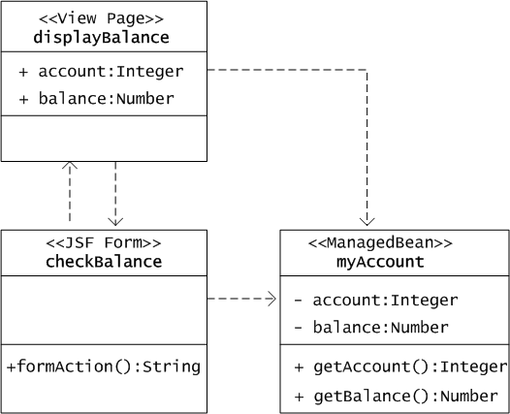
Example: Managed Bean for Processing Account Information

Slide 22
4.3 Page Navigation in JSF
The navigation in HTML forms is controlled by the action method and is performed in one step
The JSF forms navigation is performed in two steps: firstly, the FacesServlet invokes a method of the bean in the action, then it navigates to a view page to display the result
The view page is generated dynamically by the FacesServlet and is named after the action tag without any extension
A null returned value will redisplay the form

Slide 23
Example: Checking the account balance
<h:form>
<h:inputText id=“account”
value=“#{myAccount.account}”/>
<h:outputLabel for=“balance”
value=“Balance:”/>
<h:commandButton
action=“#{myAccount.balance}”
value=“submit”/>
</h:form>

Slide 24
4.4 Data Processing in JSF
Two major types of information processing is performed by the facelets: input data validation and data format conversion
Each information processing operation is specified using corresponding functional tag
  <f:convertNumber type=... />
  <f:validateLength minimum = ... />
Validation and conversion can be performed separately, or combined under one tag, when processing the same data

Slide 25
Example: Currency conversion with validating the amount
<html xmlns=http://www.w3.org/1999/xhtml
xmlns=http://java.sun.com/jsf/html”>
...
<h:inputText value=“#{myTransaction.amount}”>
<f:convertNumber type=“currency”/>
<f:validateDoubleRange
minimum=“0.00”
maximum=“10,000” />
</h:inputText>

Slide 26
4.5 Errors and Error Processing in JSF
In the case of an error in the input data the managed beans bound to it are not populated and the form is redisplayed to correct the error
By default there is no error message, but it can be specified using a separate <h:message> tag. It makes the message more specific, so it is recommended to specify it.
If the input field does not have a label attribute, the message uses system generated label. The label makes the message more focused, so it is recommended to use it.

Slide 27
Error Control in JSF
3 types of errors are controlled in JSF: Missing values, Conversion errors and Validation errors
For each type of error a suitable error message can be generated against the input field, specified using various attributes of the field
Example: Missing values error
<h:inputText value=“#{myTransaction.amount}”
converterMessage=“Unknown Currency”>
<f:convertNumber type=“currency”/>
</h:inputText>

Slide 28
5 JSP vs. JSF
Both technologies can be used for the same purpose
Both technologies hide the server-side data processing but to a different extent – JSPs allow full Java on the pages
JSF as a newer technology goes beyond JSP in the separation of input/output and backend operations which increases further the software quality

Slide 29
JSP vs. JSF
JSP Pages
JSF Facelets
Compiled and executed as individual servlets
Allow Java to be used on the JSP page, which makes them difficult to understand
Contain explicit directives to the server which mixes the control with the content
The context objects are accessed from within embedded Java scriplets and EL expressions
The Java Beans are used as ordinary Java classes
Compiled and executed as scripts by the generic FacesServlet
Use only XML syntax, which makes them easier to read
Hide the server directives in the context which separates the content from the control
The context objects are accessed only from within embedded EL expressions
The Managed Beans are used according to a template

